Slide 1

NEWS CLASSIFICATION
Gokul Nagarajan
Karthik Selvaraj

Slide 2


OBJECTIVES
Classification of news articles using supervised Machine Learning (ML) and Natural Language Processing (NLP) techniques
Evaluate each classifier’s ability to select the appropriate category given an article’s title and a brief article description

Slide 3
FEATURE EXTRACTION
This task requires us to extract features in the form of matrices (usable data format and that can be later used by various feature selection and Machine learning algorithms to correctly classify data into different classes).
1. TFIDFVectorizer() - TFIDF, term frequency–inverse document frequency, is the statistic that is intended to reflect how important a word is to a document in the corpus. This is used to extract the most meaningful words in the corpus.
2. CountVectorizer() - The collection of text documents is converted to a matrix of token counts using count vectorize that produces a sparse representation of the counts.

Slide 4
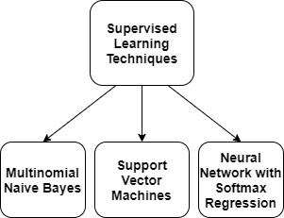
SUPERVISED LEARNING
Supervised classification of news articles is done because we have the defined classification categories.
The algorithm is trained on the labeled dataset and gives the desired output(the pre-defined categories)

Slide 5
MULTINOMIAL NAÏVE BAYES
The multinomial Naive Bayes classifier is suitable for classification with discrete features (e.g., word counts for text classification)
The multinomial distribution normally requires integer feature counts and fraction counts such as TF-IDF is used in practice.

Slide 6
SUPPORT VECTOR MACHINES
Support vector machine is highly preferred by many as it produces significant accuracy with less computation power.
It is effective in cases where number of dimensions is greater than the number of samples

Slide 7
NEURAL NETWORK WITH SOFTMAX REGRESSION
SoftMax layer is typically the final output layer in a neural network that performs multi-class classification.
SoftMax regression is a generalization of logistic regression that we can use for multi-class classification

Slide 8
Programming LANGUAGE & PACKAGES USED
Python 3.0
Numpy
Pandas
sklearn

Slide 9
DATASET
TagMyNews Datasets is a collection of datasets of short text fragments that we used for the evaluation of our topic-based text classifier.
This is a dataset of ~32K english news extracted from RSS feeds of popular newspaper websites (nyt.com, usatoday.com, reuters.com).
Categories are: Sport, Business, U.S., Health, Sci&Tech, World and Entertainment.

Slide 10
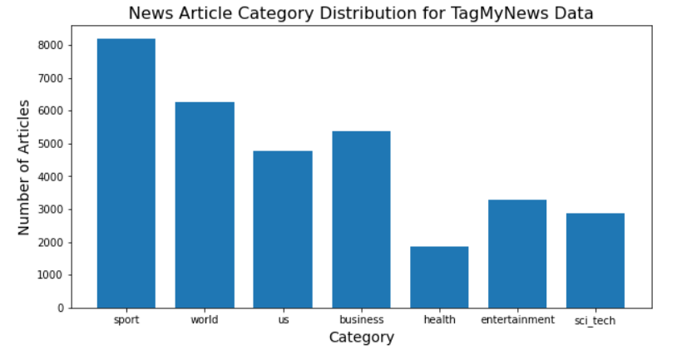
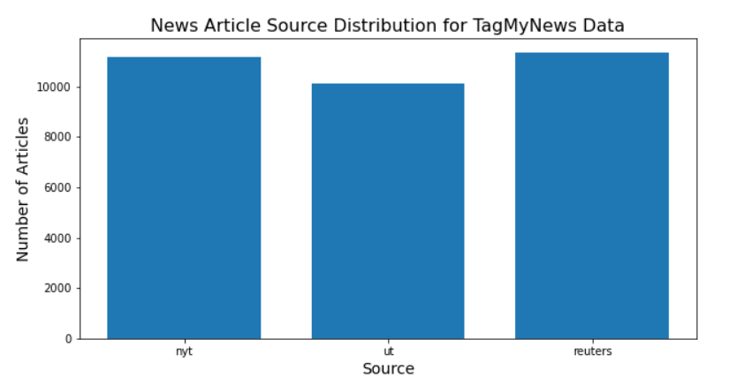

Slide 11
DATASET PREPROCESSING
Pre-processing the news article data involved three steps.
First, we separated each article’s title, description, and pre-labeled category into a separate text file, since the corpus is formatted into a single file.
Second, we removed all punctuation and stopwords from the title and description.
To test the three classifiers, we divided our data into training news articles and testing news articles. 75% of our data (24,453 articles) were designated as the training articles and the remaining 25% (8151 articles) were designated as the testing articles.

Slide 12
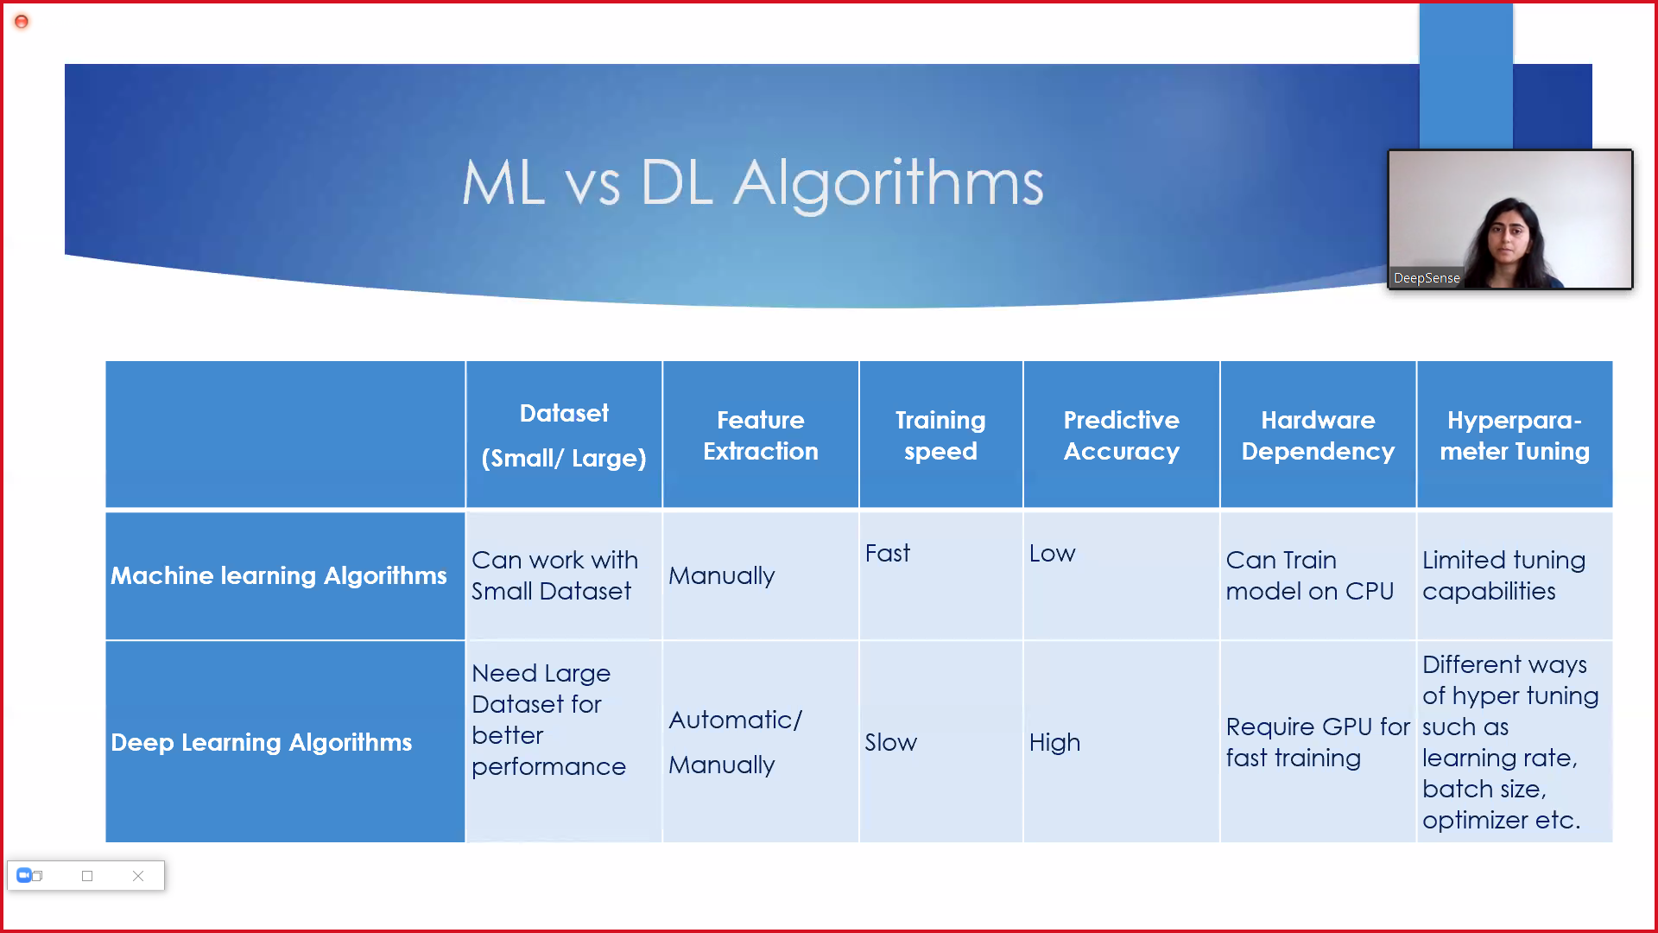
IMPLEMENTATION
Pre-processing the news article data involved three steps.
First, we separated each article’s title, description, and pre-labeled category into a separate text file, since the corpus is formatted into a single file.
Second, we removed all punctuation and stopwords from the title and description.

Slide 13
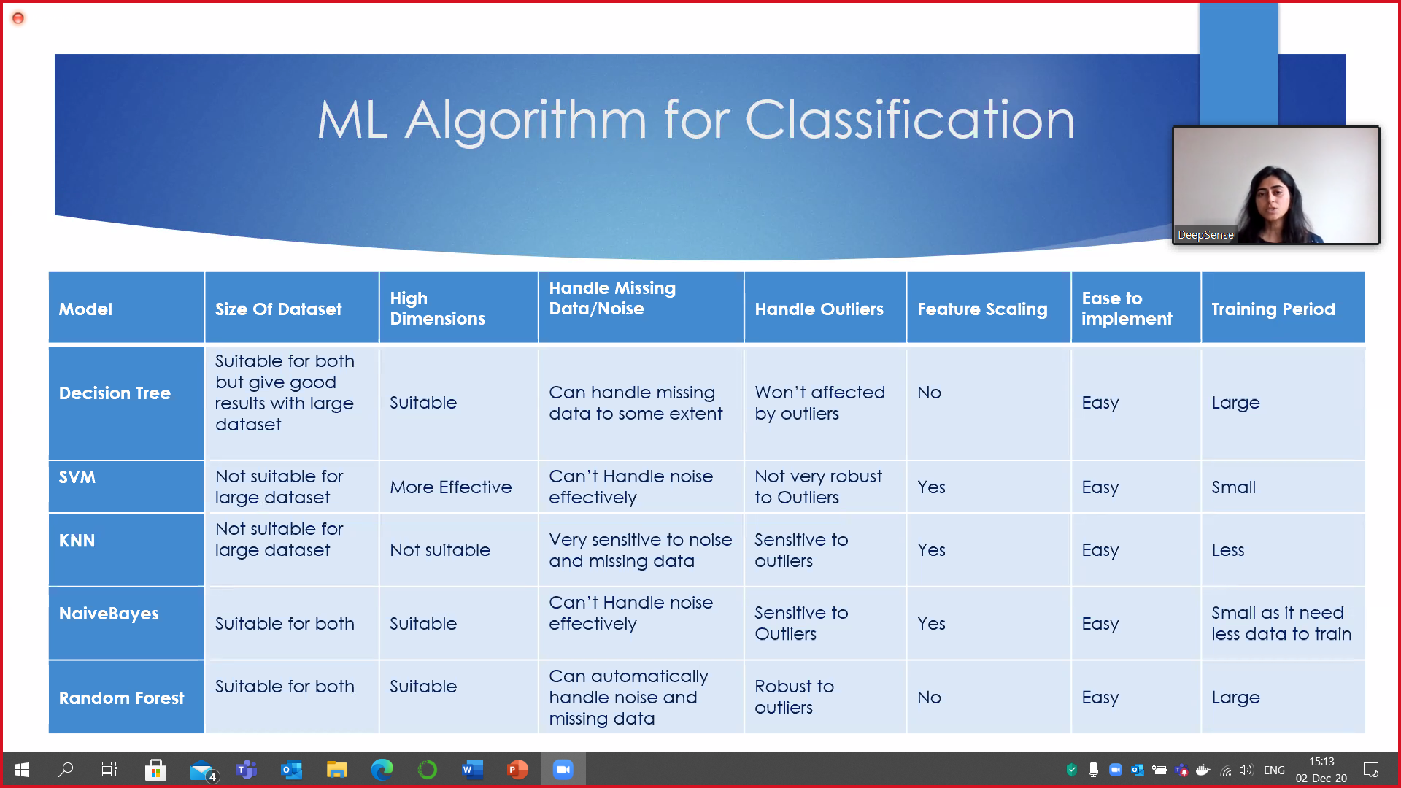
IMPLEMENTATION
Pre-processing the news article data involved three steps.
First, we separated each article’s title, description, and pre-labeled category into a separate text file, since the corpus is formatted into a single file.
Second, we removed all punctuation and stopwords from the title and description.

Slide 14
IMPLEMENTATION
Pre-processing the news article data involved three steps.
First, we separated each article’s title, description, and pre-labeled category into a separate text file, since the corpus is formatted into a single file.
Second, we removed all punctuation and stopwords from the title and description.

Slide 15
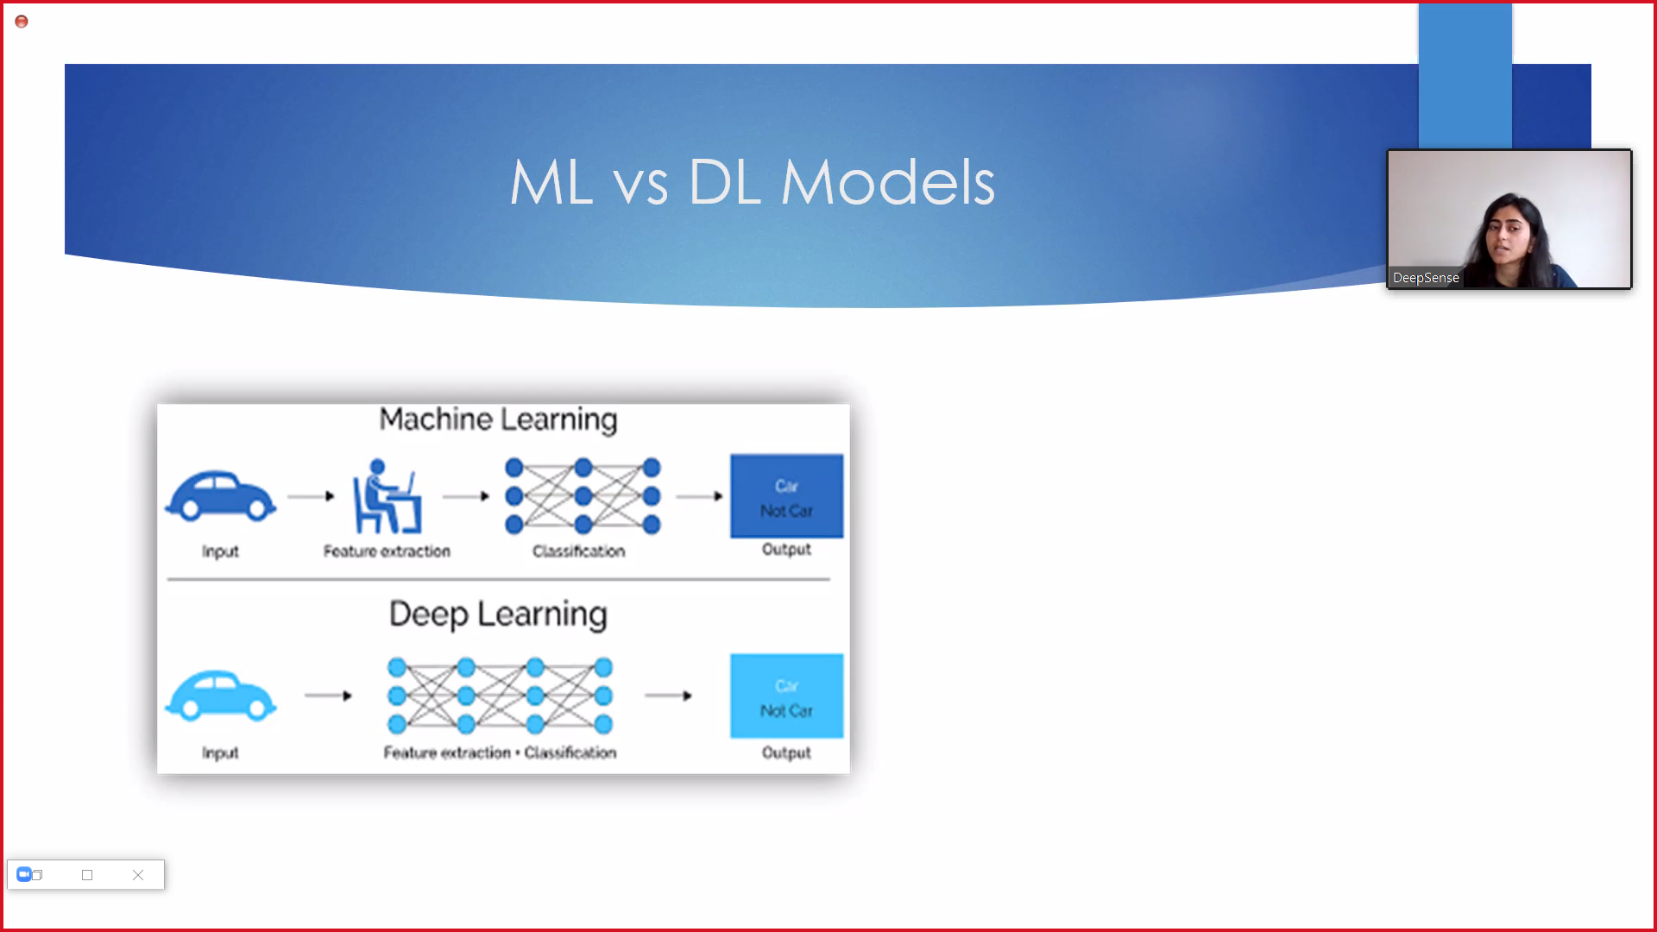
IMPLEMENTATION
Pre-processing the news article data involved three steps.
First, we separated each article’s title, description, and pre-labeled category into a separate text file, since the corpus is formatted into a single file.
Second, we removed all punctuation and stopwords from the title and description.

